Slide 1

A/B Testing Analysis Revising Sephora’s Mobile app page to Optimize Engagement
MK726 Group 2: kate bradford, jill cummins, ria nisar, nicole romangsuriat, lauren thin
Notes:
Lauren

Slide 2
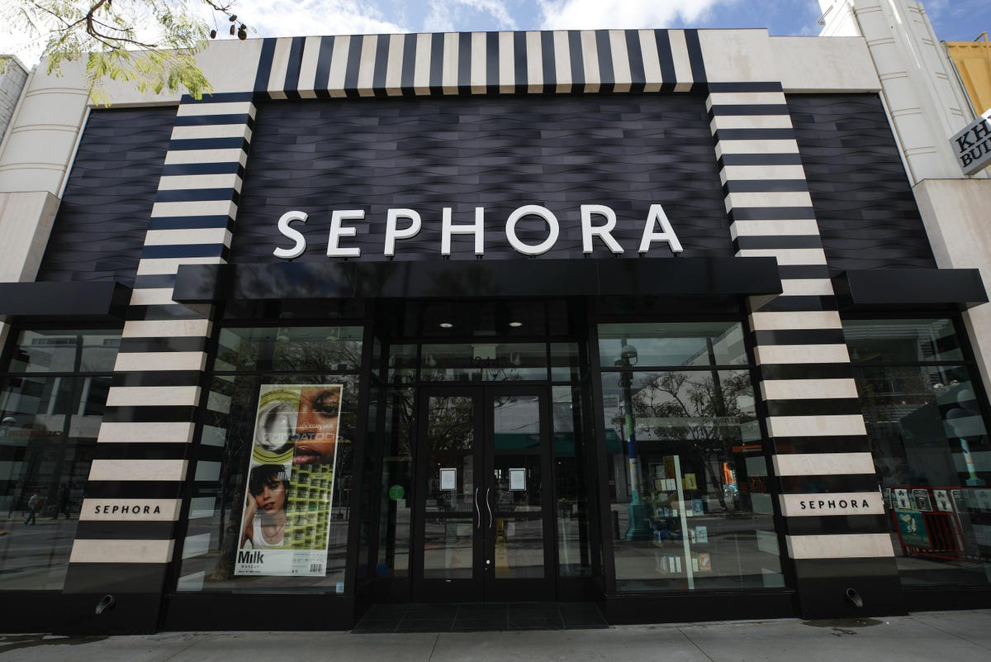
Sephora brand Introduction
Sephora is a French multinational retailer of beauty and personal care products. They are owned by LVFM and have brick and mortar stores worldwide as well as a global online presence with its website.
They have a loyalty program which is called Beauty Insider. Customers can create membership accounts by simply giving out an email and creating a password.
Members can access their accounts through the Sephora website on their computers by clicking on "sale & offers" and "beauty offers", or the website or app on their phones by clicking on the "offers" icon at the bottom of their screen.
Notes:
Lauren

Slide 3

Our experiment design involved adding 2 elements onto Sephora's existing offers page:
Independent variable of the "last chance" category
Moderator variable of category descriptions
We decided to investigate the impacts of these changes onto the dependent variable of customer engagement
Experiment
Notes:
Ria

Slide 4

10 respondents failed the attention checks, which caused us to remove their data from the 250 total responses
From the 240 responses that passed, there were slightly more male respondents and a majority that is white, between 18-29 years old, has a bachelor's degree, and has an annual income of <$10,000 illustrating that they could be students or have just entered the workforce
Sample analysis
Notes:
Kate

Slide 5

Two manipulation checks testing the "last chance" category and a created sense of urgency had passed (sig value < 5%)
One manipulation check testing the presence of category descriptions failed (sig value > 5%)
People's views on the offers page are not affected by category descriptions
We tried to filter out the extreme responses in the manipulation check failure, but that influenced other results
cannot disentangle category descriptions with "last chance" category
new focus on just the "last chance" category
Manipulation checks
Notes:
Jill

Slide 6


No Manifest Dependent Measures
3 Construct Dependent Measures
Offers Evaluation
Engagement
Loyalty
Only the Engagement measure differed across design conditions (sig value < 5%)
2-Step Conceptual Model
Engagement Loyalty
Main analysis
Notes:
Nicole

Slide 7

APPENDIX

Slide 8
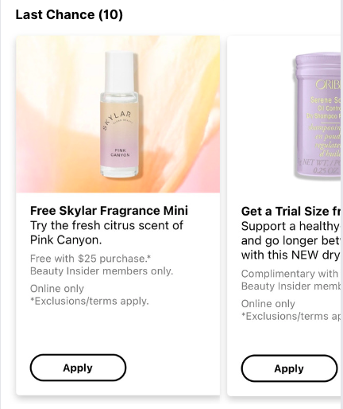
Last Chance Category
Check out these products before they run out of stock!
Category descriptions

Slide 9
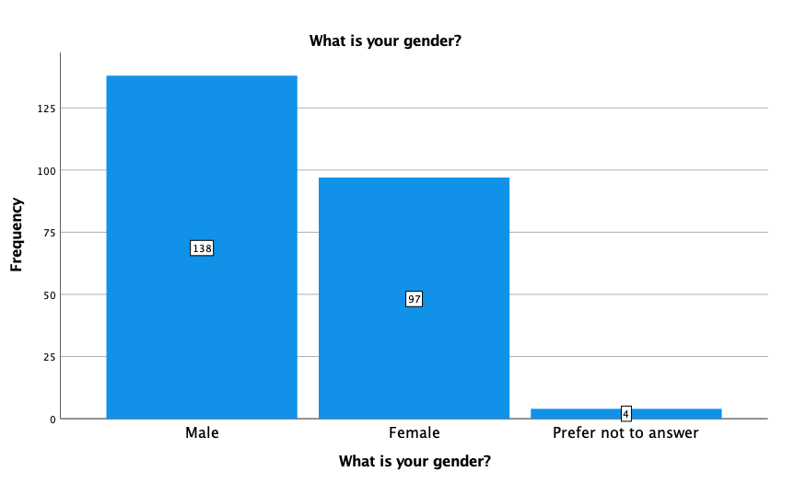
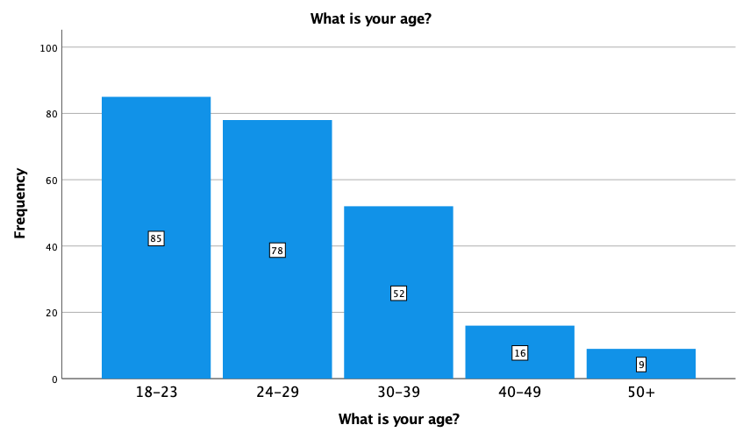
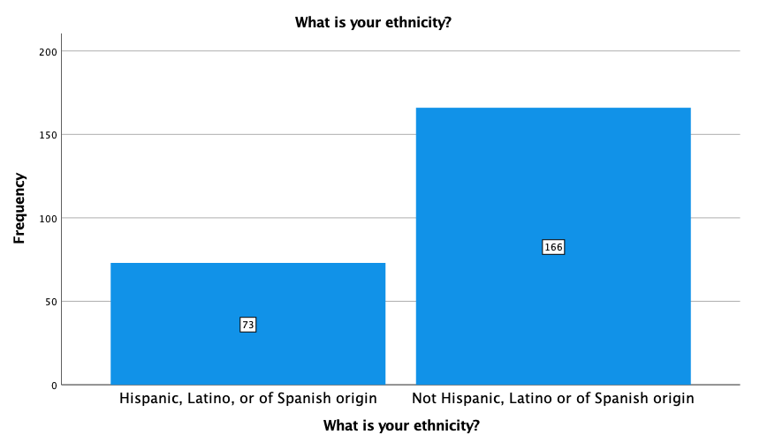
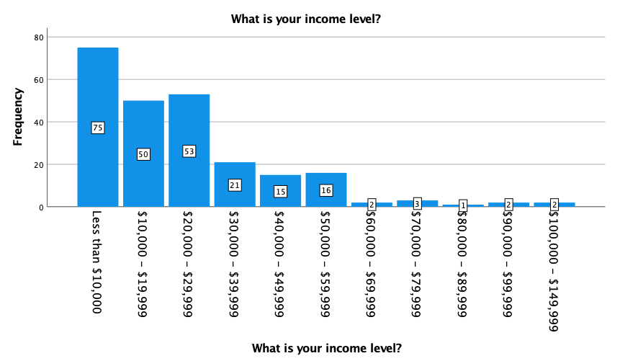
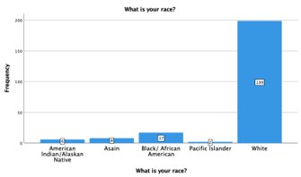
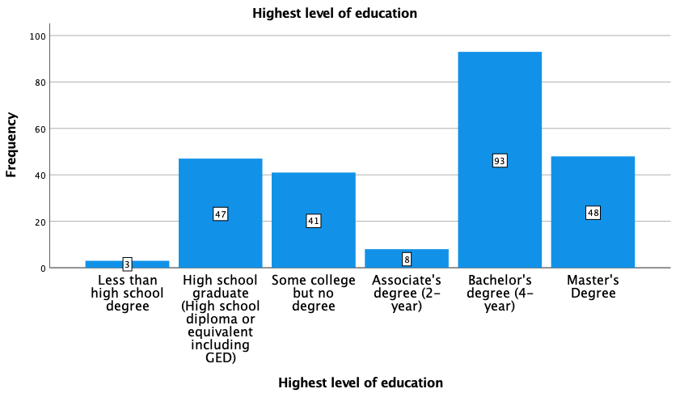
Demographics

Slide 10
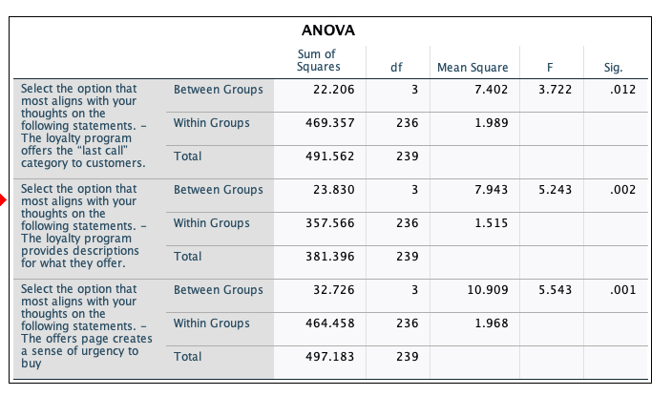
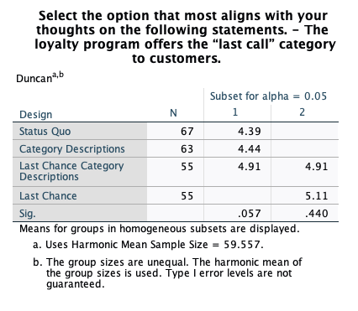
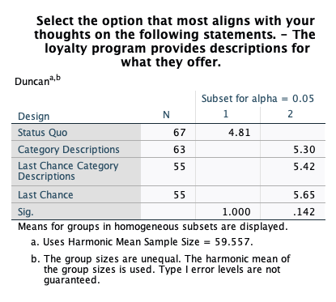
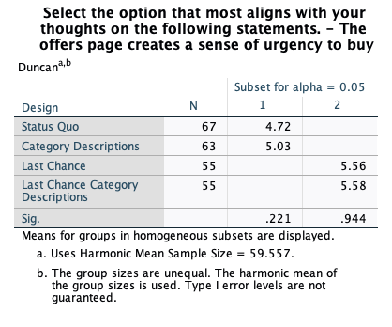
Manipulation checks post hoc analysis

Slide 11
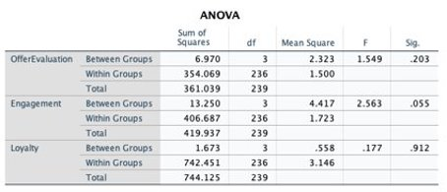
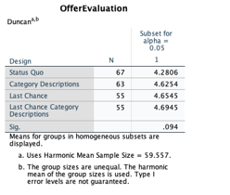


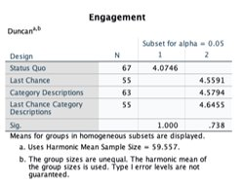
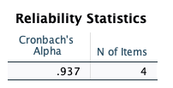
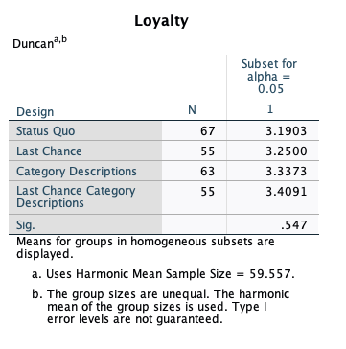
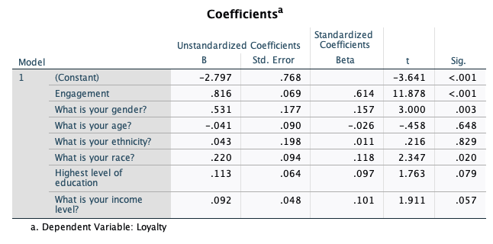
Reliability Tests:
Offers evaluation
Engagement
Loyalty
Dependent measures
Post Hoc Analysis
Linear Regression
Engagement – Loyalty

